Slide 1
COMP2003HK Computing Group Project
Group 5

Slide 2
Project Planning Process (Follow-up needed)
Articulation of the project planning process and design decisions.
Our audience is the client, so do not no need to take many time to talk about project background.
How our plan the whole project ?
Example: By what time / how much % we finish/How is the progress now ?

Slide 3
Design Decisions (Follow-up needed)
How you choose your gamification elements？
How you are paradise your functionalities？
Your choice for Platform / Program language?
Good to use Comparison or some choices that we come to our final.
Eg. We would like to use. Why was this decision made? It can't simply be because we only know XXX language.

Slide 4
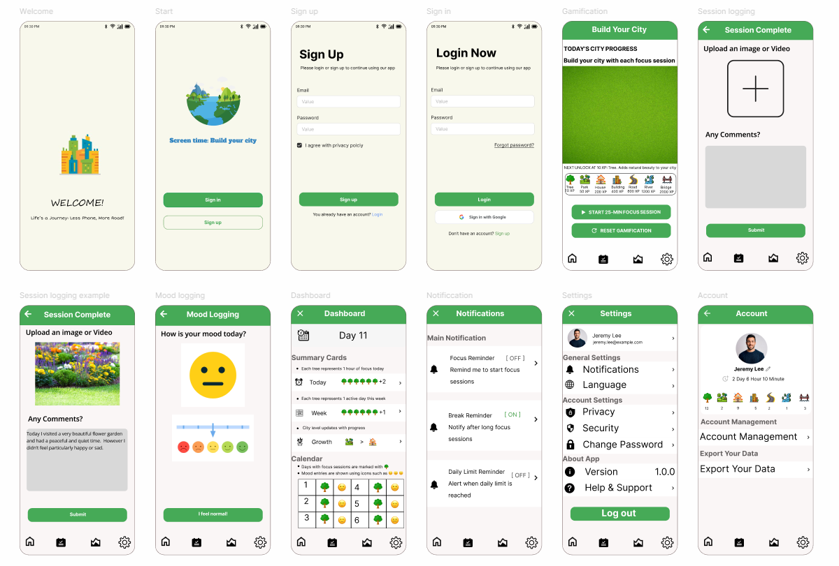
Demonstration of an initial prototype

Slide 5
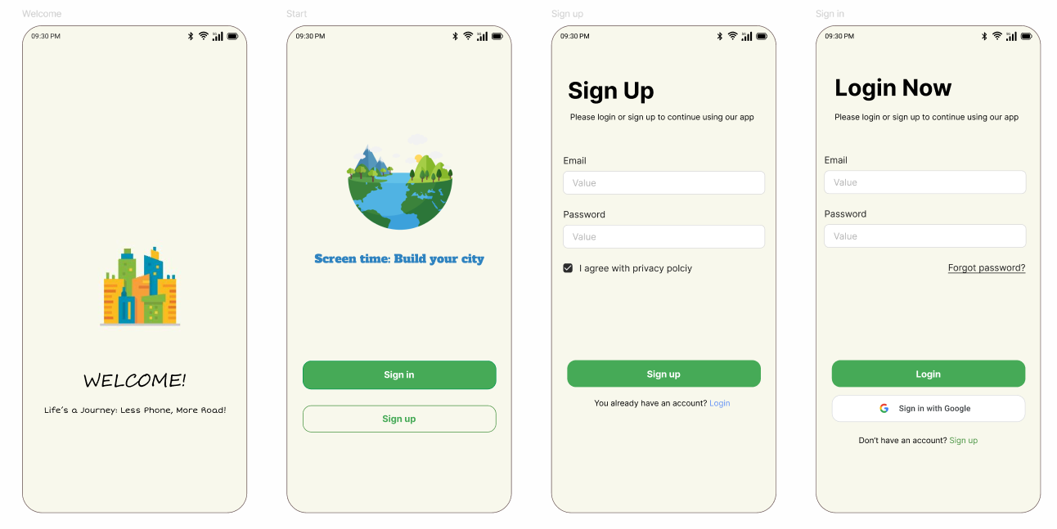
Welcome & User Login Page

Slide 6
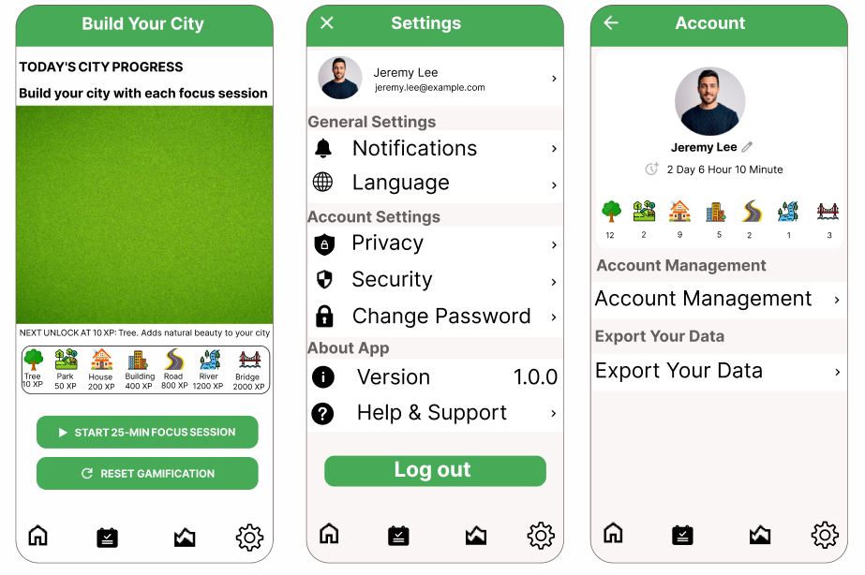
Home Page( Gamification )

Slide 7
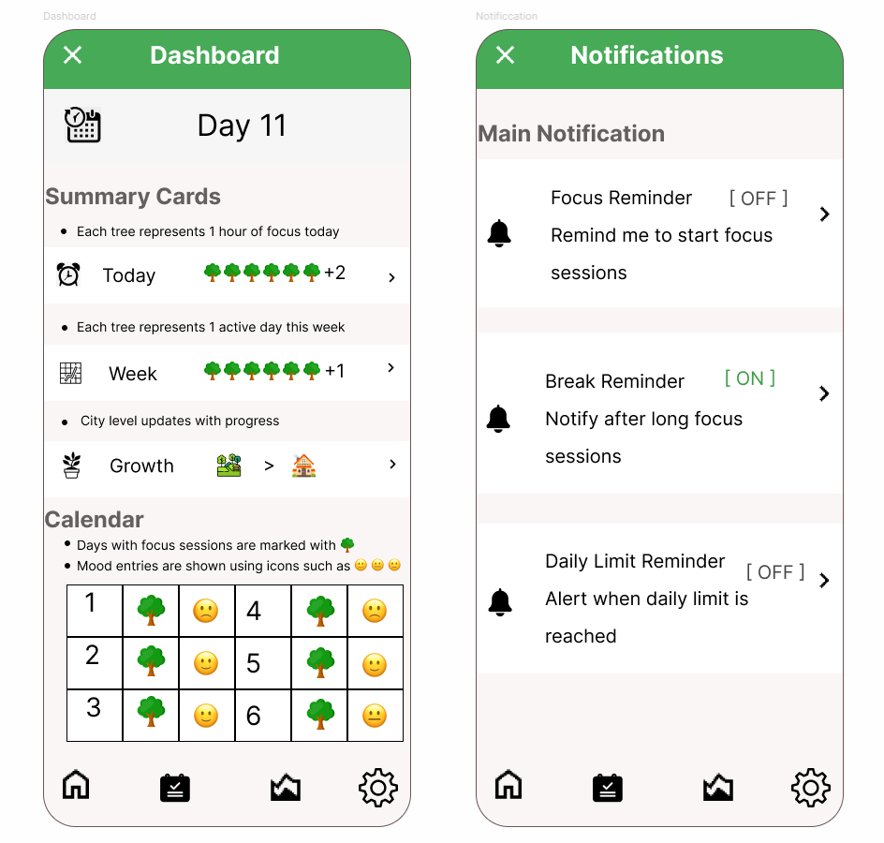
Dashboard

Slide 8
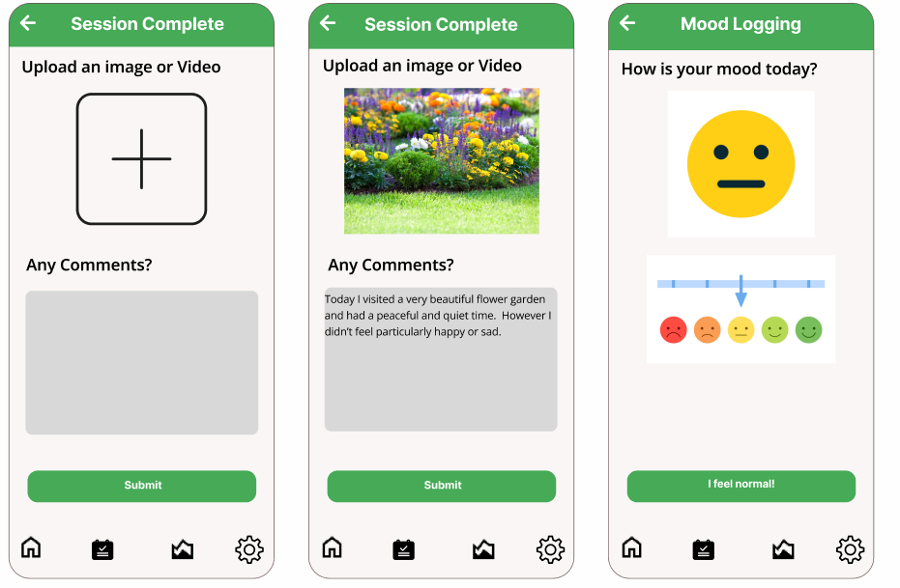
Session logging

Slide 9
Q&A
Thank You

